Slide 1

MICROSOFT VENTURE INTO THE MOVIE INDUSTRY
AUTHOR: EVANGELINE NGUNJIRI

Slide 2
PROJECT OUTLINE
BUSINESS UNDERSTANDING
OBJECTIVES
DATA UNDERSTANDING
METHODS
CONCLUSION
1
2
3
4
5

Slide 3

BUSINESS PROBLEM
- Analysis of the most profitable genres in the industry
- Analysis of the most popular production studios
- Analysis of the movies making most profits in the industry
- Analysis of language diversity in Film production to enhance inclusivity

Slide 4

OBJECTIVES
- Research current film trends and analyze box office success of various movie genres.
- Identify the most profitable and popular movie genres in the market.
- Develop a list of recommendations for Microsoft's new movie studio based on the research findings.
- Present a comprehensive report of the research findings and recommendations to the head of the new movie studio.

Slide 5

DATA UNDERSTANDING
In order to gain a comprehensive understanding of the subject matter at hand, I used the below datasets that serve as the foundation for this data analysis:
imdb.title.basics
2. bom.movie_gross
3. tn.movie_budgets
4. tmdb.movies.
5. title_ratings

Slide 6
METHODS
DATA PRE-PROCESSING
DATA VISUALISATIONS
During the data cleaning phase, several crucial tasks were performed including removing null rows, filling in missing values, and consolidating related datasets through merging. These steps ensured that the data was reliable, complete, and ready for further analysis.
The data was presented using various presentation tools such as bar graphs and line graphs

Slide 7
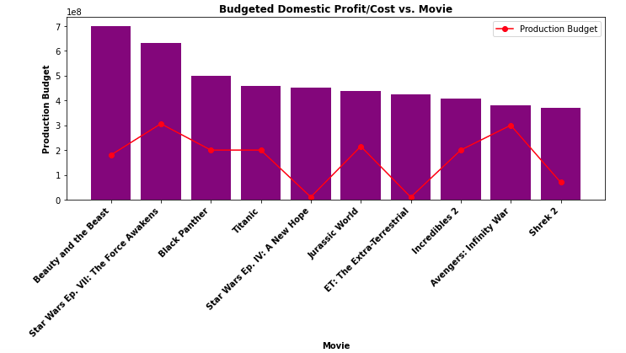
TOP 10 MOVIES BY BUDGETED DOMESTIC PROFIT
FINDINGS
Beauty and the beast(an animation) is the number 1 profit making movie while shrek 2(also an animation) is number 10.
The graph also makes it easier to compare cost and forecasted profits for planning purposes.

Slide 8
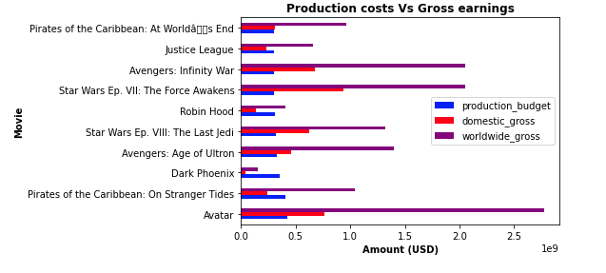
CORRELATION BETWEEN PRODUCTION COSTS AND GROSS EARNINGS
FINDINGS
There is a very weak positive correlation between the production budget and their respective domestic and global gross earnings.
This goes to say that using a lot of money in producing a movie does not necessarily guarantee profitability.

Slide 9
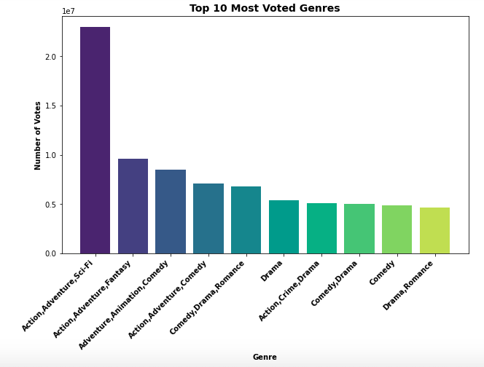
TOP 10 GENRES BY NUMBER OF VOTES
FINDINGS
(Action, Adventure, Sci-Fi), (Action, Adventure, Fantasy) and (Adventure, Animation, Comedy) are the top 3 popular genres
(Comedy, Drama), (Comedy) and (Drama, Romance) are the least popular genres.

Slide 10
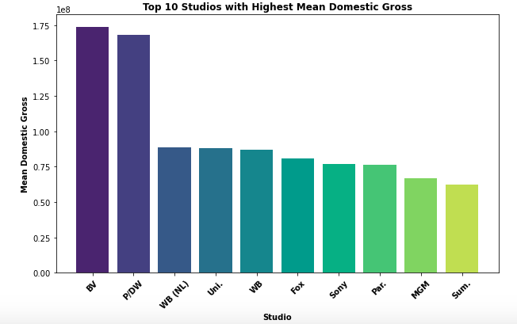
TOP 10 PRODUCTION STUDIOS BY MEAN DOMESTIC GROSS EARNINGS
FINDINGS
The top 3 earning production studios are BV, P/DW and WB (NL)
The least 3 earning production studios are Par, MGM and Sum

Slide 11
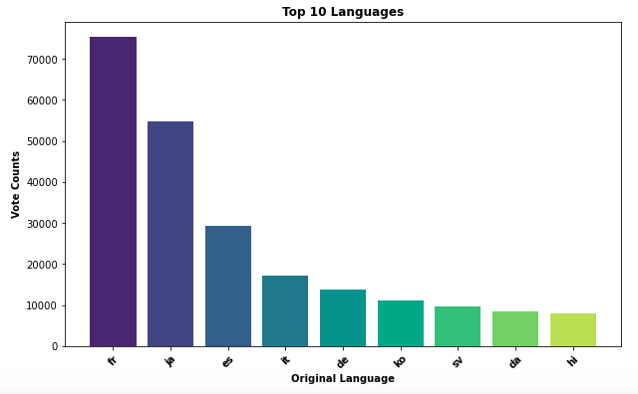
TOP 10 PREFERRED LANGUAGES BY VOTE COUNTS
FINDINGS
Aside from English which was an outlier, Fr, Ja and Es are the top 3 popular languages
The least 3 popular languages Sv, Da and Hi
Diversification in languages is important to attain inclusivity.

Slide 12
CONCLUSION AND RECOMMENDATIONS
From my analysis, these are the action points I would recommend Microsoft to undertake in order to venture into the industry with a competitive edge:
1.Diversify movie languages to attract specific niche populations
2. Encourage audience feedback
3. Focus on popular genres 4. Collaboration with successful production studios
5. Incorporate modern technology to their data analysis for current and predictive analysis

Slide 13

Thank you
Evangeline Ngunjiri
0723236813
evangeline.ngunjiri@student.moringaschool.com
https://github.com/EvangelineNgunjiri

